Slide 1
Microtesting Being smarter about how we test by embracing simplicity and continuous improvement.
Rob Moore
Principal Consultant
@robdmoore

Slide 2
Why microtesting?
Notes:
(Rob)
Let’s get the burning question out of the way…
On a more serious note: We’ve been finding that with the testing strategies we’ve been using lately we’ve been writing less tests and getting more out of it.

Slide 3
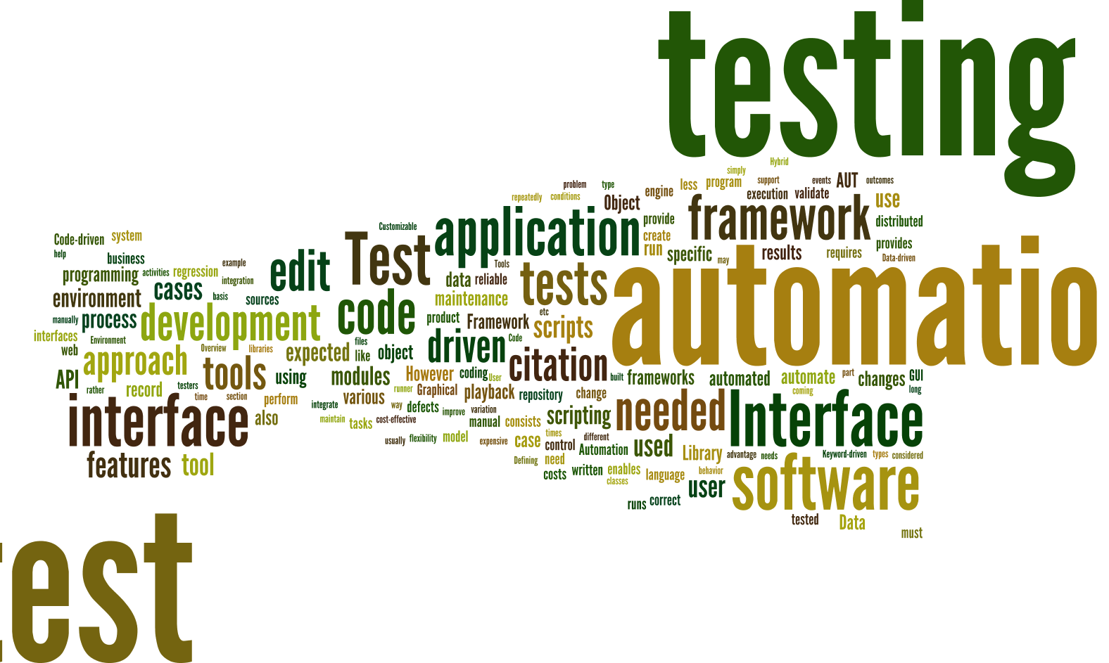
Notes:
(Matt)
Created by piping http://en.wikipedia.org/wiki/Test_automation into http://www.wordle.net/
As consultants we get to move within a number of different projects and industries.
Seen a lot of approaches over the last few years and seen what a lot of companies have done these
Experimented with a number of different approaches ourselves
Done a lot of research into what people are saying and doing

Slide 4

Notes:
(Matt)
http://en.wikipedia.org/wiki/Landfill
We’ve seen (and written) some awful, awful test code
Made our fair share of mistakes and learned a lot

Slide 5
Chapter 1: Confidence
“The testing pyramid is the answer to all our questions”
Notes:
(Matt)
In our dedication to improving our testing, we’ve made an number of realisations and we thought it would be helpful to explain these before we go into our current approach.

Slide 6
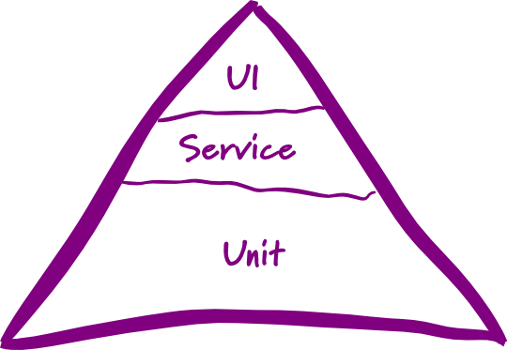
Testing pyramid
☹
Notes:
(Matt)
http://martinfowler.com/bliki/TestPyramid.html
This is the testing pyramid that you probably first heard about at uni – you have a breakdown of tests that looks something like this:
Most organisations we go into either have limited testing, or have an approach based on something like this. We see this everywhere.
Mostly low level unit tests
A smaller of number of service level or integration tests
An even smaller number of UI or system level tests
[transition]
We hate the testing pyramid. There are 3 Problems we have with it:
You have to care about the type of tests rather than what confidence you’re getting from them – how many people waste time arguing if a test is unit/integration/etc.? That’s a WASTE OF TIME
One-size-fits-all approach for all your projects that doesn’t give you the flexibility we feel you need across projects
It also doesn’t take into account the relationship between speed and confidence…

Slide 7

Speed
?
vs confidence
Notes:
(Rob)
https://www.flickr.com/photos/davidvillarreal/8732245026/
Speed vs confidence
By speed we mean speed of feedback – how quickly do we get feedback as to whether or not the codebase is ok
Confidence – how much certainty do your tests give you that your software is okay

Slide 8
* Ignoring other factors – this is just looking
at speed and confidence
Speed
“unit” tests
real database calls
Automated UI testing
Manual testing
Confidence
Notes:
(Rob)
Automated or UI testing – all other considerations aside (human error, reliability etc) those two forms of testing take a lot of time to run but give you a lot of confidence the system is working because they act as a real user and exercise the entirety of the system as a user would.
Unit tests – super quick feedback but you aren’t exercising the system as a user is – so you aren’t as sure that all the pieces are working together correctly.

Slide 9
Jimmy Bogard’s testing pyramid
😐
Slow as
hell
Slow
Fast
Notes:
(Rob)
https://vimeo.com/68390508
Jimmy Bogard presented an alternative testing pyramid in his Holistic Testing talk at NDC Oslo in 2013.
Jimmy provides a breath of fresh air when throwing away the testing pyramid (and all the conflicting definitions of unit, integration, etc. tests) in favour of a pyramid that has a small number of “slow as hell tests”, a slightly larger number of “slow” tests and a lot of “fast” tests.
This is great as it helps us start to focus on something important about the tests – the speed of feedback – but doesn’t go far enough in my opinion since it doesn’t take confidence into account and is still a one-size-fits all strategy.

Slide 10
Our testing pyramid?
Notes:
Wait!? Where is the pyramid?
…
…
Oh there it is!

Slide 11


☺
Notes:
Matt
We fundamentally disagree with the concept of a testing pyramid – as we’ve previous said, it’s too rigid and doesn’t you offer any flexibility between projects.
If you drop the pyramid, then what should guide your decision around how and what to test?
People will be lost, they will be walking around in a daze not knowing what to do?
We think you should turn to what’s important?

Slide 12
“The ultimate goal here is to ship code it’s not to write tests; tests are just a means to the end of shipping code.” “I can have 100% code coverage and have noone use my product and I can have 0% code coverage and it’s a huge success; there is no correlation between the two things.”
Jimmy Bogard
Confidence, rather than coverage, is key
Notes:
(Matt)
The answer is confidence, here is a great quote from Jimmy Bogard from his Holistic Testing talk at NDC 2013.
https://vimeo.com/68390508

Slide 13
The goal of testing is not to test.
Our goal should be to get enough confidence as quickly as possible.
Notes:
The goal of testing is not to test.
We see this all the time
(usually with the justification of that’s the way we’ve always done it, or we have to or the auditors will get us)

Slide 14
Speed of release
You can only release when you meet your minimum confidence level.
Speed of release
Fear of refactoring
Manual regression testing
Wasted time fixing regressions
Brittle tests (low confidence)
Lots of time running tests
Lots of time writing tests
Automated tests
Notes:
(Rob)
To figure that out we want to look at what’s really important.

Slide 15
tl;dr * Speed and confidence are inversely proportional * Testing pyramid is too rigid – we can be smarter * The goal of testing is not to test * Confidence is the most important driver * Speed up releases w/ pragmatic automated testing
Notes:
(Matt)

Slide 16
Chapter 2: “The Business”
“Business people can get their hands off my testing strategy”
Notes:
(Rob)

Slide 17
“Challenge yourself to start simple then inspect and adapt”
Notes:
(Rob)

Slide 18
Setting a testing strategy
Challenge yourself to set a minimum confidence level that is as low as possible
Create a testing strategy that meets that confidence level as fast as possible
Adjust the testing strategy over time based on observations (inspect and adapt)
Notes:
(Matt)
Go back to original point on confidence.
1. Most stakeholders will say 100% confidence but that actually means you’ll never get anything shipped out the door. Being pragmatic, we actually want to challenge ourselves to set our confidence level as low as possible for our business needs. in combination with techniques like continuous delivery, we can optimise our testing strategy to be able to react quickly and efficiently to mistakes that do happen. Really a business decision rather than a technical decision because you’re trading speed vs confidence, and this is something a business person will care about – they care about speed out to users vs likelihood that it will break.
2. Increases agility and supports CD
3. Your first attempt at this doesn’t have to be right – but it should be simple.
How many bugs are getting to production?
How fast is your team delivering features?
How confident or scared are you when your product is pressing the button to deploy to production?

Slide 19
Where does “The Business” come into it?
Challenge yourself to set a minimum confidence level that is as low as possible
Create a testing strategy that meets that confidence level as fast as possible
Adjust the testing strategy over time based on observations (inspect and adapt)
Business Decision
Technical Decision
Both
Notes:
In reality the decision about how much confidence is enough should be a business decision. The decision about how to achieve that in the fasted way possible is a technical decision and it’s importan that both parties are looking to inspect and adapt since there will be business metrics (how many bugs are there, how fast are we delivering features from ideation to real users) and technical metrics (how long does it take us to write tests, how many tests break when we refactor, how long do our test runs take, etc.).

Slide 20
What do we need for an effective conversation about confidence?
Consistent terminology (keep everyone on same page)
Traceability
Consistency of approach
Giving non-technical people an understanding of the impact of their decision

Slide 21
Business Investment Designation*
Capture risk / confidence trade-off by designating each feature/story with one of:
Critical – Death or serious injury possible, significant legal impact possible, critical business impact
High – Serious injury possible; high business impact
Medium – Non serious injury possible; moderate business impact
Low – Minor business impact / inconvenience
Trivial – Minimal impact
Track the BID within task tracking system

Slide 22
Business Investment Designation*
Then create testing strategy based on BID, e.g.:
Critical – more time spent in upfront design (this isn’t just about testing) and out-of-band testing, use of intensive techniques like model-based testing that can enumerate all possibilities when testing
High – developer testing, automated UI testing and charter-based manual testing
Medium – developer testing and exploratory manual testing
Low – Exploratory manual testing
Trivial – No testing
Thus, BID will affect estimate from dev team

Slide 23
Is that an oversimplification?
Yes and no.
Notes:
(Rob)
So you might ask – Is that a simplification? Surely you don’t use one type of test (the fastest possible for a confidence level) across your whole app.
[Reveal]
Yes and no.
Confidence level needed will likely change across different parts of the application.
But, we typically start with a broad brush testing strategy and let the inspect and adapt cycle run it’s course. Besides, in most of the apps we work on the majority of the application will be very similar, and then a few parts of it will be “special” and need different treatment. That’s where the inspect and adapt bit comes in to save the day.

Slide 24
Enterprise Grade Testing™
Don’t restrict the team and the PO
Make it per-project, allow per-feature
Actually change it over time
Notes:
(Rob, Matt)
So, because we work for enterprises, we need enterprise-driven right?
We need to set our strategy, show it at CAB and then apply it synergistically across the organization so they are all consistent.
Then we can hire a separate team of testers to roll out the testing strategy across all teams and keep the developers honest because we don’t trust them…
NO. Just stop. Srsly.

Slide 25
tl;dr * Minimum confidence needed is a business decision * The technical team can decide the fastest way to reach that confidence * Embrace continuous improvement for your testing
Notes:
(Matt)

Slide 26
Chapter 3: Subcutaneous
“Mocking frameworks are our saviour”
Notes:
(Matt)
A major part of the strategy that we have been using involves a technique called Subcutaneous Tests

Slide 27
UI
MVC Controller / MVVM View etc.
Subcutaneous Test
Domain / Services / Repositories etc.
Database
External System
Notes:
(Matt)
One-level below the UI e.g. MVC controller
Full stack of production dependencies wired in
Application-owned datasources wired in
External dependencies mocked out
Good speed/confidence balance between all UI tests and all “unit” tests

Slide 28
Advantages
Testing behaviour → acceptance criteria → ATDD, executable specification
High amount of confidence
Reasonably fast without the fragility of UI tests
Refactoring friendly ☺
Less: tedious mocking code
Notes:
(Matt)

Slide 29

Silver bullet!?
Notes:
(Rob)
https://www.flickr.com/photos/eschipul/4160817135
Not a silver bullet, there are some disadvantages and some limitations you need to be aware of. There are ways of working around or dealing with them though.

Slide 30
Disadvantages
Hard to get complete coverage of complex code
Combinatorial explosion
Hard to know why broken
Multiple test failures
Test complexity – lots of moving parts
Notes:
(Rob)
Explain the points, then look at the ways around them:
Complex code – use a different type of test (or combine)
Hard to know why broken – stack traces and the debugger are you friend along with good code organization and small number of layers in your code, your test tooling can help too –the BDD framework I use makes it easier to isolate for instance
Multiple test failures – pick one, focus on fixing it then re-run all tests
Test complexity – refactoring and use patterns – see my subcutaneous testing talk to .NET UG

Slide 31
tl;dr * Sub-c testing balances speed and confidence * Mocking implementation details leads to pain * Sub-c testing isn’t a silver bullet
Notes:
(Matt)

Slide 32
Chapter 4: “unit” tests
“I don’t write a line of code without TDD”

Slide 33
Implementation tests (“unit” tests)
In-memory, in-process, low-level, implementation-focussed
Lightning fast, but lower confidence
Inhibits ability to safely/painlessly refactor
Important tool in the right situation
Useful to drive impl/support of complexity
Decision point – throw away or keep?
Notes:
(Matt)

Slide 34
Chapter 5: UI Automation
“We have to stop writing code for 3 months so we can build the UI testing framework”

Slide 35
Automated UI tests
High confidence
Slow and fragile
Great for complex UIs and high-value scenarios
It’s a cost-benefit trade-off: don’t blindly cover everything in them – be smart
Notes:
(Matt)

Slide 36
Chapter 6: Walkthrough
“Because that’s the way we do things around here”
Notes:
(Matt)

Slide 37
Context
Small to Medium line-of-business apps
Many industries: education, telecomm., financial
Relatively small proportion of complex algos
Not real-time / life-or-death
Using continuous delivery
Notes:
(Matt)
Another note is that we will inspect and adapt this testing strategy throughout a project.

Slide 38
Example testing strategy
Subcutaneous tests for feature happy paths and important error paths
In-memory full stack HTTP server requests for API calls
Small, but judicious use of convention tests, route tests, integration tests, “unit” tests, end-to-end tests and UI tests
Notes:
(Matt)

Slide 39
Chapter 7: The role of testers in a Agile/DevOps team
A good tester is worth their weight in gold!
Notes:
(Matt)

Slide 40
Testers
DevOps != Dev + Ops
Testing mindset = Gold
Backlog refinement
Kick-off
Collaborative testing discussions
High-value testing

Slide 41
Thoughts
Advocate for end users
Advocate for speeding up the team
Don’t just follow the testing pyramid, do manual regression testing or automated UI testing
Be smarter and free up time to do high value tasks
Notes:
End users = UX and trying to get things out faster and then actually getting real feedback
Think about how testing can speed up and slow down the team and try and promote the former

Slide 42
High-value tasks
Limitless PD opportunities:
Exploratory testing
Penetration testing
Performance testing
Load testing
UX testing
A/B testing
Testing automation
…

Slide 43
Chapter 8: Sustainably subcutaneous; show me the code
“Integrated tests are a scam”
Notes:
(Matt)

Slide 44
Demo Implementation (“unit”) test vs subcutaneous test
Notes:
(Rob)

Slide 45
Behaviour Driven Tests
Confidence
Focus
Easy to read and write
Tip: If you’re using .NET, look into TestStack.BDDfy
Notes:
(Rob)

Slide 46
Demo Bddfy / class per scenario
Notes:
(Rob)

Slide 47
Driving tests via DI container
Helps avoid implementation details
Ensures production code paths
Easy to selectively provide mocks
Tip: Use child lifetime scopes to isolate test runs and incur container startup cost once only
Notes:
(Matt)

Slide 48
Demo Driving tests via DI container
Notes:
(Rob)

Slide 49
Avoiding mocks / Hand-rolling
Avoids implementation details
Only mock external dependencies
Hand-rolled mocks – make mocking painful
Allow behaviour to be codified
Tip: Create standard request/response pairs for APIs as a cross-cutting testing concern
Notes:
(Matt)

Slide 50
Demo Hand-rolled mock example
Notes:
(Rob)

Slide 51
Object Mother / Test Data Builder
Two powerful patterns that complement
Improves consistency, clarity of intent, tests-as-documentation, readability, maintainability
Allows you to simplify complex data setup
Tip: If you are using .NET check out TestStack.Dossier

Slide 52
Demo Test data generation example
Notes:
(Rob)

Slide 53
Approval Tests
Test HTML / JSON / XML / text / images etc.
Use human brain & avoid tedium of assertions
Pin down complex behaviour quickly and easily
Get a nice diff view when things change
Tip: Available for most languages & if you are using .NET check out Shoudly’s ShouldMatchApproved
Notes:
(Rob)

Slide 54
Demo Approval Test
Notes:
(Rob)

Slide 55
Demo Putting it all together…
Notes:
(Rob)

Slide 56
Questions to ask… Are you happy with amount of effort, overall confidence and speed of feedback? How can you make testing simpler? How can you continuously improve your testing?
Notes:
(Matt)

Slide 57
Thankyou! Questions?
http://bit.ly/microtesting #microtesting
Matt Davies
Principal Consultant
@mdaviesnet
Rob Moore
Principal Consultant
@robdmoore

Slide 58
Further reading
http://robdmoore.id.au/blog/2015/01/26/testing-i-dont-even/
http://robdmoore.id.au/blog/2013/05/26/test-data-generation-the-right-way-object-mother-test-data-builders-nsubstitute-nbuilder/
http://robdmoore.id.au/blog/2014/01/23/test-naming-automated-testing-series/
https://vimeo.com/68375232
https://vimeo.com/68390508
https://github.com/robdmoore/TestingPatternsWithDossierPresentation
https://github.com/robdmoore/SubcutaneousTestsPresentation

